Slide 1
Molecular Profiling of MPA/DMBA-Induced Mouse Mammary Tumors
Christian Fougner
Medical Student Research Program
Thesis Defense
24.11.2017
Notes:
Good afternoon. First I would like to thank you all for coming to my thesis defense, and in particular to express my gratitude to Randi Mathisen and Haakon Benestad for taking the time to be here as examiners. Today I will be presenting the research described in my thesis, titled “Molecular Profiling of MPA/DMBA-induced Mouse Mammary Tumors”.

Slide 2
Introduction
Notes:
Before presenting my own research, I will start by giving you a brief overview of the field.

Slide 3
Breast Cancer
Heterogeneous, multistage disease
Malignant neoplasm of the mammary ducts or lobules
Worldwide highest incidence cancer in women
Fifth highest mortality
Breast cancer progression (Breastcancer.org, 2017)
Historical breast cancer incidence, mortality and survival in Norway (Cancer Registry of Norway, 2016)
Notes:
While commonly referred to as a single disease, breast cancer is in fact a collection of multiple, heterogeneous diseases. As an entity, breast cancer is characterized by malignant neoplasms of the mammary ducts or lobules. In this presentation I will be focusing on cancers originating in the mammary ducts. Before becoming invasive, breast cancers generally progress through several stages – as depicted in the left figure - starting with ductal hyperplasia with or without atypia, followed by the progression to ductal carcinoma in situ, referred to as DCIS. If not discovered and surgically removed, DCISes will in most cases become invasive, and eventually metastasize. Metastases are frequently found in bone tissue, the brain, the liver and/or the lungs, at which point the illness is considered incurable.
In terms of epidemiology, breast cancer is the form of cancer with the worldwide highest incidence in women, and carries the fifth highest mortality of all cancers. The graph displayed shows the historical incidence, mortality and survival of breast cancer in Norway. This reveals an increasing incidence, with rates almost doubling from 1965 to 2015. This is however contrasted with a decreasing mortality, and an increasing 5 year survival. This improvement is largely ascribed to earlier diagnosis, and improved therapies. Nonetheless, breast cancer still causes over half a million deaths every year worldwide, and research into improved therapies, and diagnostic and prognostic tools remain important topics of research.

Slide 4
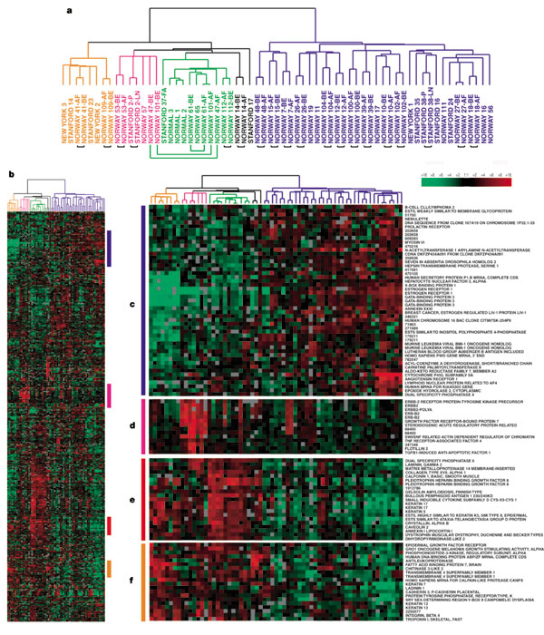
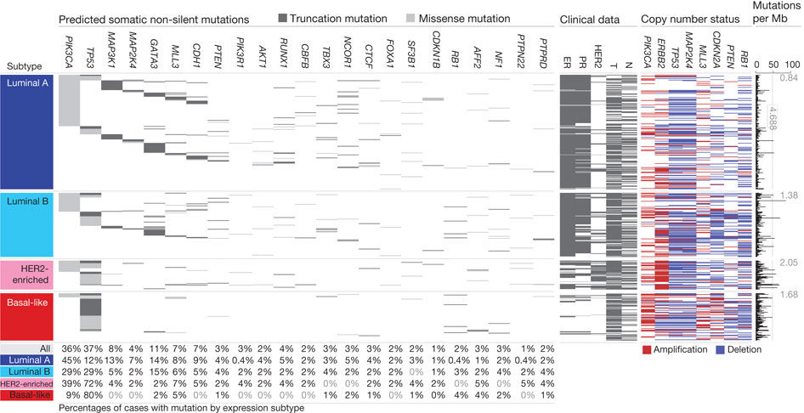
Breast Cancer Genomes and Transcriptomes
Somatic mutations and copy number aberrations in human breast cancers (The Cancer Genome Atlas Network, 2012)
Breast cancer subtypes (Perou et al. 2000)
Notes:
It has long been possible to measure the expression of single genes, or to sequence single genes. In the past 20 years, it has however become possible to measure gene expression levels across the entire transcriptome, and to sequence entire genomes or exomes. This is now possible at reasonable prices and in short time frames.
The breast cancer transcriptome was first described by Chuck Perou and my supervisor Therese Sørlie in the early 2000s. These analyses revealed several subtypes of breast cancer with distinct gene expression patterns and clinical outcomes. There are six gene expression subtypes of breast cancer, referred to as the intrinsic subtypes, named luminal A, luminal B, basal-like, HER2, normal-like, and the more recently discovered claudin-low. These subtypes are strongly correlated with distinct expressions patterns hormone receptors. These subtypes are therefore considered distinct disease entities, each with different underlying biologies, prognoses and therapy responses.
Whole genome and exome sequencing of breast tumors revealed a heterogeneous set of mutations. The genes PIK3CA and TP53 were for example found to each carry mutations in approximately a third of breast cancers. Mutations in other genes were however found at far lower rates. Several genes were strongly correlated to subtype, such as PIK3CA mutations in Luminal A and B, and HER2+ tumors, while TP53 mutations are most frequently found in basal-like tumors. There was however no single mutation or set of mutations which could predict the tumor’s gene expression subtype. It has also more recently been found that breast cancer’s carry a high rate of copy number aberrations, and it is now thought that breast cancers are more strongly driven by copy number aberrations than mutations.

Slide 5
Mouse Models of Breast Cancer
Used for pre-clinical trials and basic biology research
Several types:
Genetically engineered mouse models (GEMMs)
Patient derived xenografts (PDXs)
Transplanted cell lines
Chemically induced models
Several anatomical and physiological differences
Estrogen receptor signaling of less importance
Terminal end buds vs. lobules
Notes:
Mouse models are commonly used for cancer research, in particular for the pre-clinical testing of drugs and for research into basic tumor biology. Mouse models of cancer can broadly be placed into 4 categories.
Genetically engineered mouse models carry germline mutations known to induce cancer. While these mutations are found in all of a mouse’s cells, it is possible to isolate their expression to the mammary glands through the use of the mouse mammary tumor virus. Genetically engineered mouse models are particularly useful for studying the effect of a single mutation, but are unlikely to capture the genomic diversity found in human cancers. Additionally, these tumors are generally driven by the given transgene, and are therefore unlikely to adequately represent the effect of copy number aberrations in breast cancer.
Patient derived xenografts are human tumors, transplanted into immunodeficient mice. PDXs are composed of human tumor tissue, and are therefore thought to be the model which most closely reflects human breast cancer. Lack of a functioning immune system is however a major weakness of PDXs.
Cancer cell lines from existing murine tumors can be transplanted into immunocompetent mice, but there are few such well characterized cell lines, and the extent to which they represent human disease is unclear.
Finally, mammary cancers can be induced by the administration of carcinogenic chemicals, thereby initiating a mutagenic process causing cancer. This yields a diverse range of tumors in immunocompetent mice. However, breast cancer in humans does not appear to be caused by carcinogens. There is therefore debate regarding the validity of these as a model for human breast cancer.
It must also be noted that there are several anatomical and physiological differences between mice and human mammary glands. Most importantly, estrogen receptor signaling appears to be of less importance in mouse mammaries than in humans. Murine tumors are therefore suboptimal models for research directly related to estrogen receptor signaling. Also of note, mouse mammary glands have a simpler ductal structure, with ducts terminating in so called Terminal End Buds – this in contrast to the complex branching lobules found in humans. This is of particular significance when studying mammary development, and it’s relationship to tumor initiation and cancer stem cells.

Slide 6
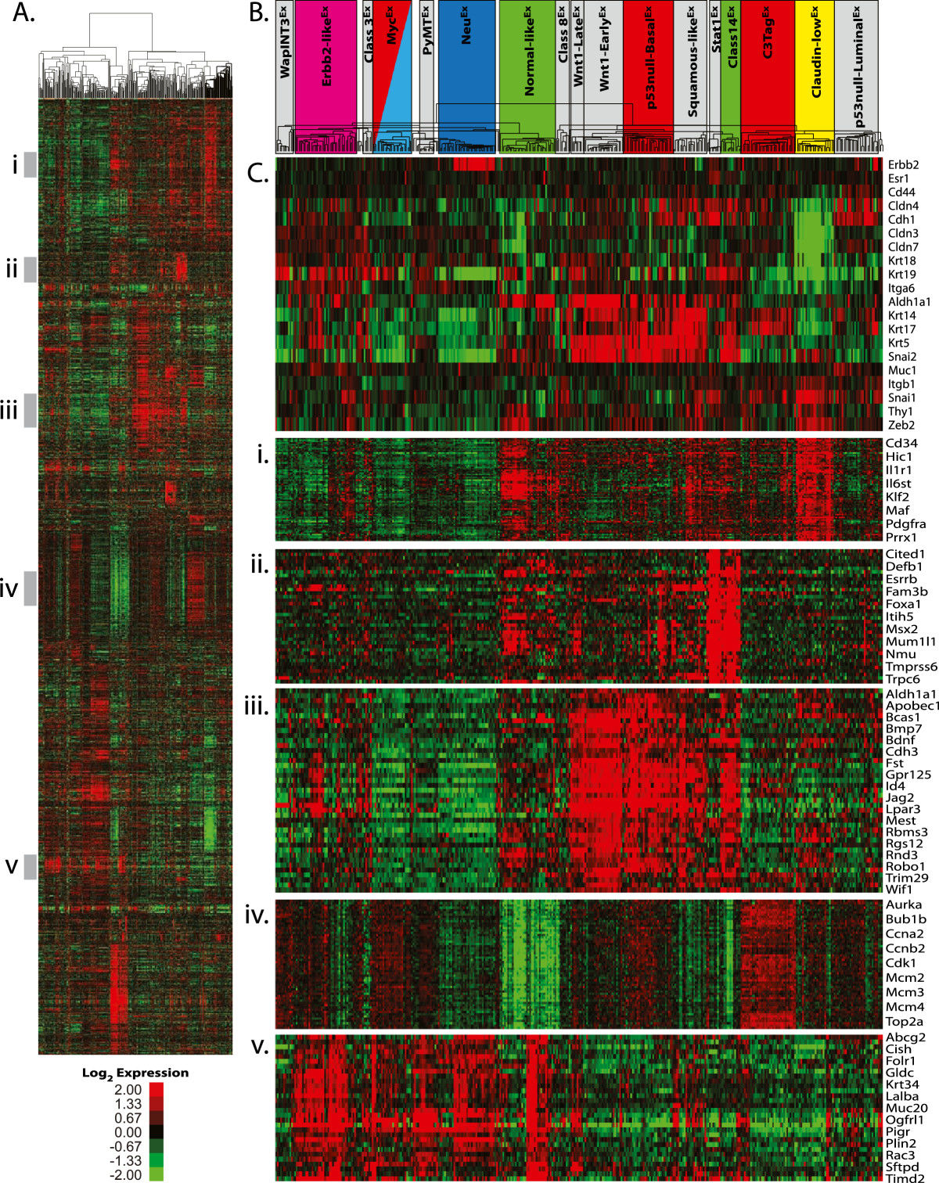
Transcriptomic Mouse Mammary Tumor Analyses
Gene expression analysis frequently carried out
Meta-analysis of 27 mouse models revealed 17 murine expression-based subtypes
11 homogeneous models
6 semi-homogeneous models
9 heterogeneous models
Mouse mammary tumor subtypes (Pfefferle et al. 2013)
Notes:
Due to the importance of the breast cancer subtypes, gene expression analyses are frequently carried out on novel mouse models of breast cancer. In 2013, Adam Pfefferle and colleagues carried out a metaanalysis of 27 mammary tumor models, of which the majority were genetically engineered. Their analyses revealed 17 distinct murine subtypes, showing a greater range of gene expression patterns than that found in human breast cancers. While many models displayed homogeneous expression patterns, several models displayed heterogeneous expression patterns despite the tumors mostly being initiated by a single, consistent mutation. This heterogeneity highlights the frequent lack of association between specific mutations and the resulting tumor subtype.

Slide 7
Genomic Mouse Mammary Tumor Analyses
Few mouse mammary tumor models have been sequenced
DMBA-induced tumors (Abba et al. 2016)
Blg–Cre Brca2 ^{f/f}Trp53 ^{f/f} (Francis et al. 2015)
Trp53-null (Pfefferle et al. 2016)
Significant differences compared to human breast cancer
Large inter-model variation
Notes:
Despite the importance of genomic aberrations in cancer, few mammary tumor models have undergone sequencing. This may be due to the expense of sequencing experiments, as well as a lack of researchers with expertise in analyzing sequence data from mice. We have have only been able to find 3 models of mammary cancer which have undergone exome or genome sequencing, a sample size which doesn’t allow for any broad conclusions to be drawn. At this point, there does however appear to be a large degree of variation between these 3 mouse models, and they display significant differences when compared to human breast cancer.

Slide 8
MPA/DMBA Induced Carcinogenesis
DMBA: 7,12-Dimethylbenz[a]anthracene
Polycyclic aromatic hydrocarbon
Carcinogen
DNA damage by formation of DMBA/DNA adducts
Immunosuppressive effect
Exposure through tobacco smoke, diet and occupational exposure (aluminum production, fossil fuel processing)
Oral administration in mice induces mammary tumors
MPA: Medroxyprogesterone acetate
DMBA chemical structure
Notes:
As I have discussed, there exist several categories of mouse models of cancer, each with strengths and weaknesses. Chemically induced models of breast cancer are of particular interest, due to their ability to recapitulate the entire tumorigenic process, in an immunocompetent model, and with a breadth of genomic events not seen in genetically engineered models.
Mammary cancers can be chemically induced by the administration of medroxyprogesterone acetate and 7,12-dimethylbenzanthracene, respectively known as MPA and DMBA. DMBA is a polycyclic aromatic hydrocarbon known to have a carcinogenic effect. This appears to be mediated through two mechanisms. When DMBA comes in contact with DNA, it binds to DNA and forms what is known as DMBA/DNA adducts. This causes DNA damage and is mutagenic. Additionally, DMBA exposure has an immunosuppresive effect by inducing apoptosis in lymphoid tissues. Humans may be exposed to DMBA and other polycyclic aromatic hydrocarbons through exposure to tobacco smoke, foods and occupational exposures such as aluminium production and fossil fuel processing. DMBA may be orally administered to mice, in which case mammary tumors may arise. Less frequently gastric tumors may also arise.
MPA is a progestin, and when implanted as a subcutaneous pellet in addition to DMBA administration, increases rate of mammary tumor formation. It is known that MPA leads to a proliferation of cells in the mammary glands. Thus, there is an increase in the number of cells in the mammary gland upon which DMBA can induce mutations, thereby increasing the likelihood of initiating a mammary tumor.

Slide 9
Genomic and Transcriptomic analyses of MPA/DMBA-induced tumors
Transcriptomic analyses
Described by Yin et al. 2005, Abba et al. 2016, included in meta-analyses Herschkowitz et al. 2007 and Pfefferle et al. 2013
Heterogeneous gene expression patterns
Squamous-like (4/11), claudin-low-like (3/11), and three other subtypes (4/11)
Genomic analyses
Exome sequencing by Abba et al. 2016 of DMBA-induced tumors with (n = 9) and without MPA (n = 13)
High mutation frequency
Pik3ca mutations frequent without MPA, otherwise heterogeneous
Notes:
Gene expression analyses have been performed on MPA/DMBA-induced tumors, first by Yin and colleagues in 2005, and again by Abba and colleagues in 2016. They were also included in the previously mentioned metaanalyses of mouse mammary tumor models. These showed that MPA/DMBA-induced tumor models have a highly heterogeneous gene expression, with 5 different murine subtypes being found in 11 tumors.
Tumors initiated by DMBA, with and without MPA were recently sequenced by Abba and colleagues. This revealed a high frequency of mutations, several times that found in human breast cancers. They also found that Pik3ca mutations were frequent in those tumors initiated solely by MPA. Tumors initiated by MPA and DMBA however displayed more heterogeneous expression patterns. Notably, only 9 MPA/DMBA-induced tumors were sequenced, a sample number far too small to draw meaningful conclusions from when analyzing such a heterogeneous model. Therefore, more research is required in order to adequately characterize MPA/DMBA-induced tumors.

Slide 10
Aim
Is the MPA/DMBA-induced mouse model of mammary tumors a valid and/or useful model of human breast cancer?

Slide 11
Material and Methods

Slide 12
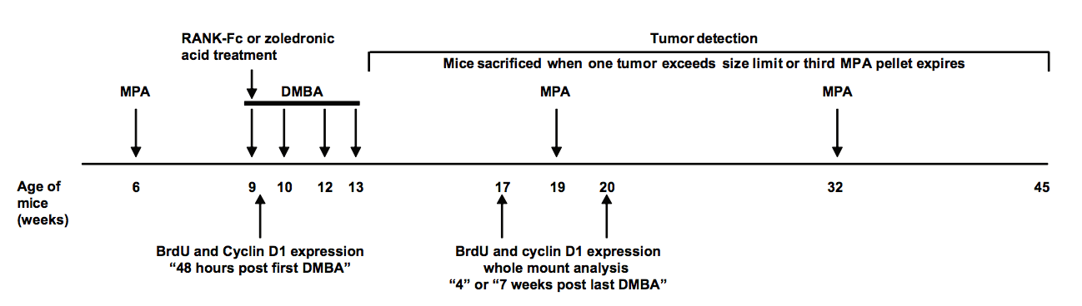
MPA/DMBA-induced carcinogenesis
MPA/DMBA protocol (Gonzalez-Suarez et al. 2010)
18 mammary tumors analyzed
Mice sacrificed at average age of 186 days (26 weeks, 4 days)
Multiple mammary tumors in 4 mice
Notes:
The MPA/DMBA-induction protocol is shown here. An MPA pellet was implanted subcutaneously into female FVB/N mice at 6 weeks of age. 1 mg of DMBA was administered orally at 9, 10, 12 and 13 weeks of age. MPA pellets only release hormones for 90 days, necessitating the implantation of a second pellet at 19 weeks of age. Mice were sacrificed once tumors reached a sufficient size, or at week 32 when the second MPA pellet expired. In this study, we analyzed 18 tumors from 14 mice, sacrificed at a mean age of 26 weeks and 4 days.

Slide 13
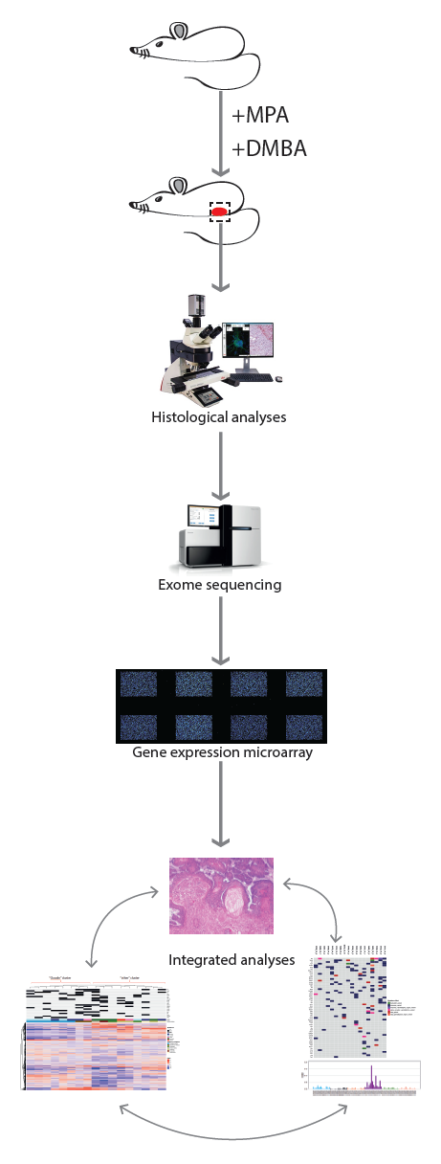
Tumor analyses
Histological evaluation
H+E staining
Evaluated by animal pathologist
Immunohistochemical staining
K5, K18, ERα , PR, HER2, Ki67
Whole exome sequencing
100x coverage
Agilent mouse all exon kit, run on Illumina HiSeq
Sanger sequencing
70 mutations sequenced
Analysis pipeline (gene expression analyses not included in presentation)
Notes:
The analysis pipeline is shown to the right here. Once the tumors were harvested, tissue sections were stained with hematoxylin and eosin, and evaluated by an animal pathologist. Tissue sections were also subjected to immunohistochemical staining. We stained for the basal marker K5, the luminal marker K18, the profileration marker Ki67, and for the relevant hormone receptors ER, PR and HER2. Tumors were then subjected whole exome sequencing at a 100x coverage, using the industry standard Agilent mouse all exon kit, run on an Illumina Hiseq. For validation purposes, 70 mutation which were discovered from the exome sequences were sequenced using the Sanger method.
My colleague Helga has also run gene expression microarrays on these tumors, but her results will not be discussed in this presentation.

Slide 14
Results

Slide 15
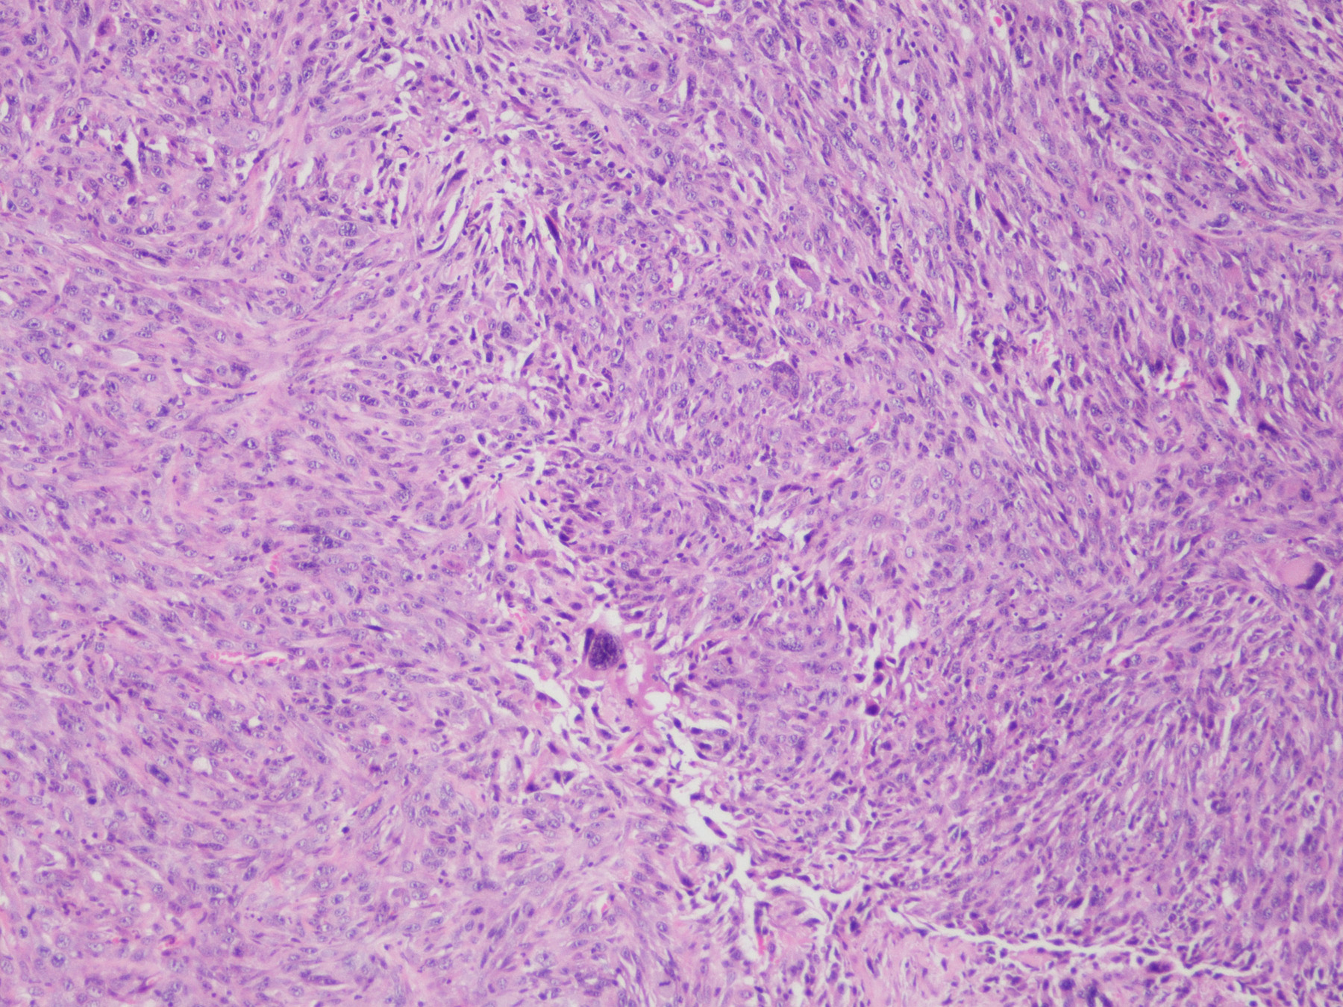
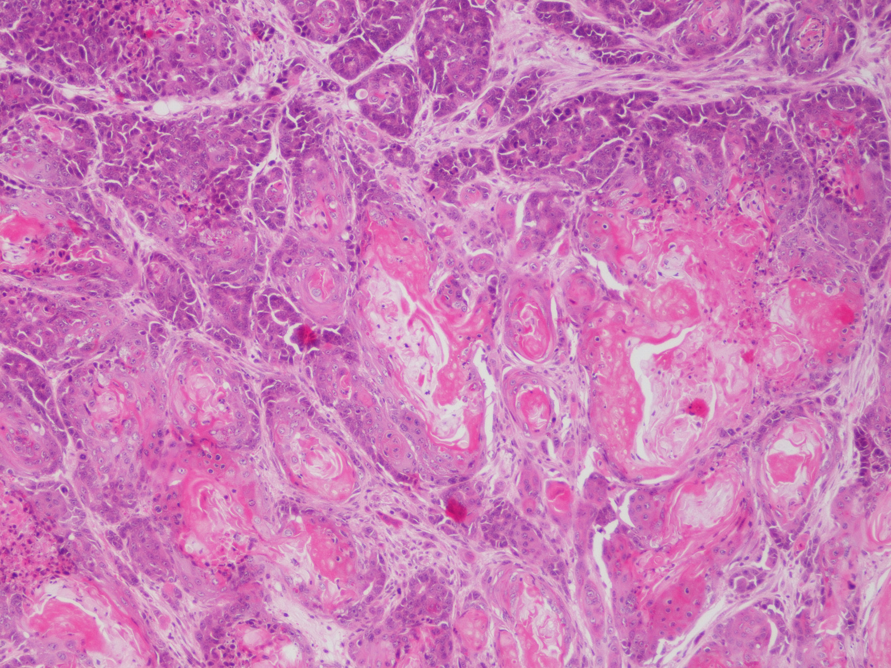
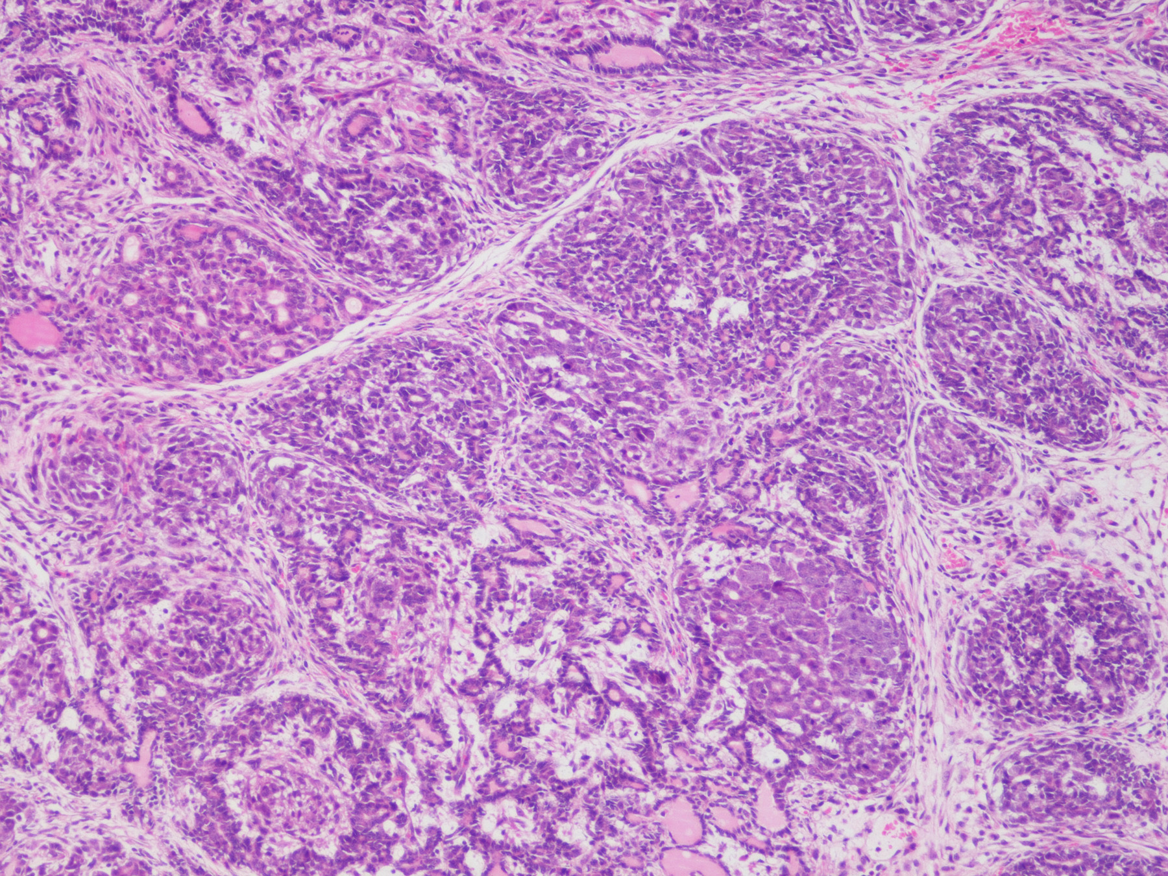
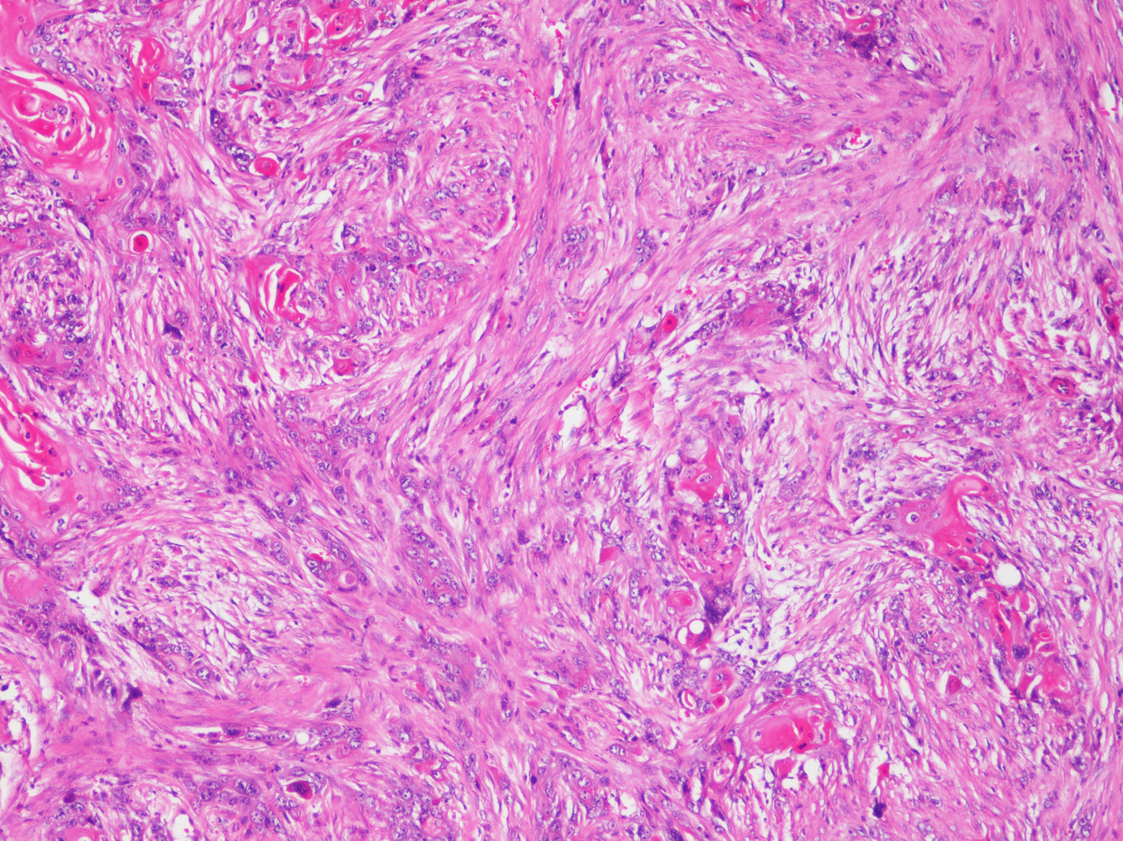
Histology
MPA/DMBA-induced tumors are histologically heterogeneous
Spindle cell components (6/18 tumors)
Frequent cornification
Squamous cell carcinoma characteristics (4/18 tumors)
Inflammatory features
S131_14_9
S153_14_2
S416_15_2
S189_14_2
Selected hematoxylin and eosin stained tumor tissue sections
Notes:
At a histological level, MPA/DMBA-induced tumors displayed a strong diversity. Four HE stained sections are shown here, displaying a subset of the discovered histological characteristics. Spindle cell components and cornification were frequently seen, a finding which is uncommon for human breast cancers and more frequently seen in sarcomas. Squamous cell carcinoma characteristics was also seen in many tumors, a finding also rarely seen in breast cancer. At a histological level, it therefore appears that MPA/DMBA-induced tumors show a high divergence from human breast cancers. Inflammatory features were seen in most tumors, confirming immunological activity despite the immunosuppressive effect of DMBA. It can also be noted that in the 4 mice carrying two tumors, the tumor pairs generally showed varied morphologies. This increases the likelihood of these tumors being independent primary tumors, rather than metastases.

Slide 16
Immunohistochemical Markers
Sample name | K5 | K18 | ER | PR | HER2 | Ki67 (%)
S123_14_6 | Positive | Negative | Positive | Positive | Negative | 9
S131_14_9 | Positive | Negative | Negative | Negative | Negative | 48
S132_14_5 | Positive | Negative | Positive | Positive | Negative | 40
S153_14_2 | Negative | Positive | Positive | Positive | Negative | 28
S159_14_2 | Negative | Positive | Negative | Negative | Negative | 19
S159_14_8 | Negative | Negative | Negative | Negative | Negative | 8
S160_14_2 | Negative | Positive | Positive | Positive | Negative | 27
S176_14_2 | Negative | Positive | Positive | Negative | Negative | 39
S187_14_1 | Positive | Positive | Negative | Positive | Negative | 47
S189_14_2 | Positive | Negative | Positive | Positive | Negative | 20
S189_14_4 | Negative | Negative | NA | NA | Negative | 20
S400_15_2 | Positive | Negative | Positive | Positive | Negative | 18
S400_15_7 | Positive | Negative | Positive | Positive | Negative | 30
S401_15_2 | Positive | Positive | Positive | Positive | Negative | 25
S412_15_2 | Positive | Positive | Positive | Positive | Negative | 41
S416_15_2 | Positive | Positive | Positive | Positive | Negative | 4
S416_15_13 | Negative | Positive | Positive | Positive | Negative | 18
S422_15_2 | Positive | Positive | Positive | Positive | Negative | 2
Heterogeneous expression of basal and luminal markers
K5: 11/18, K18: 10/18, both: 5/18, neither: 2/18
Heterogeneous expression of ERα and PR
ER:13/17, PR, 13/17, both: 12/17, neither: 3.
No HER2 positive tumors
Varied proliferation rates
No significant associations found between immunohistochemical markers
K5: cytokeratin 5 (basal marker), K18: cytokeratin 18 (luminal marker), ER: estrogen receptor, PR: progesterone receptor, HER2: human epiderman growth ffactor receptor 2, Ki67 = profileration marker
Notes:
Immunohistochemical markers also showed a marked divergence between tumors. 11 of 18 tumors expressed the basal marker K5, and 10 of 18 tumors expressed the luminal marker K18. 5 tumors expressed both markers, while 2 tumors expressed neither. While these markers are often used as a marker for cell of origin and a surrogate marker for subtypes, the existence of double positive and double negative tumors makes the interpretation of these results challenging. In tumor pairs from the same mouse, 3 of 4 pairs showed divergent cytokeratin staining, furthering our belief that these are independent tumors and not metastases. In total, 13 tumors stained positively each for ER and PR, of which 12 stained positively for both. 3 tumors stained positively for neither hormone receptor. No tumors expressed detectable amounts of HER2. Proliferation rates, as measured by Ki67, diverged strongly, ranging from 2% to 48%. We did not find any significant associations between any hormone receptors and cytokeratins, nor associations between proliferation rate and cytokeratin or hormone receptor status.

Slide 17
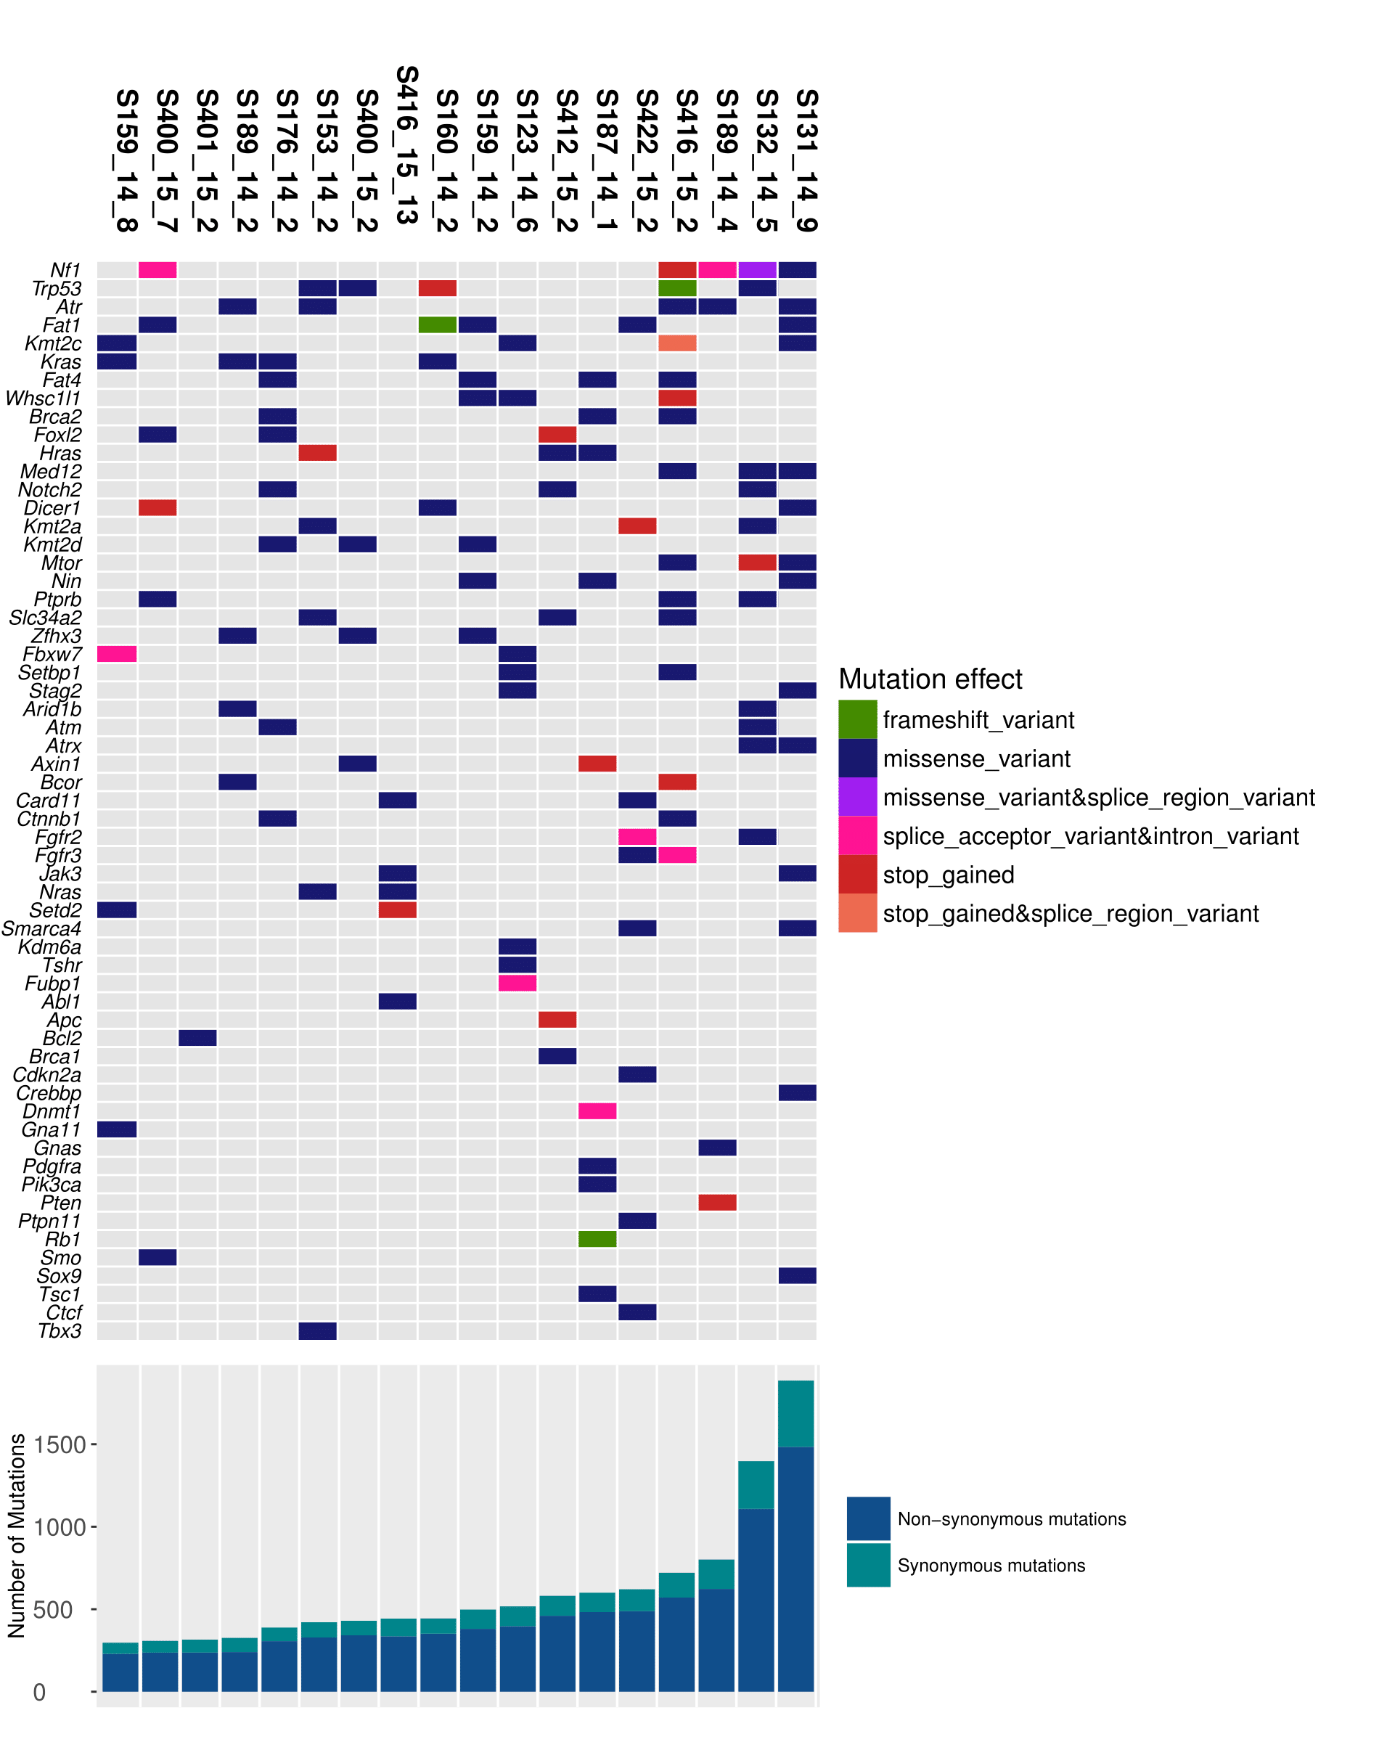
Driver Gene Mutations
288 – 1795 exonic mutations per tumor
Median = 459
Mutation rate: 5.81 – 36.21/MB
Median = 9.26/MB
Mean in human breast cancer: 1.31/MB
Most frequently mutated driver genes:
Nf1 (5/18, 28%)
Trp53 (5/18, 28%)
Atr (5/18, 28%)
Fat1 (5/18, 28%)
Kras (4/18, 22%)
Kmt2c (4/18, 22%)
Fat4 (4/18, 22%)
Top panel: mutations in selected driver genes.
Bottom panel: Total number of exonic mutations
Notes:
Sequencing revealed a very high rate of mutations in MPA/DMBA-induced tumors, with tumors carrying between 288 and 1795 exonic mutations per tumor, with a median of 459 mutations. As can be seen from the bottom panel, most mutations are found to be non-synonymous. The divergence in mutation rates as also apparent from this graph. When averaged across the entire exome, this reveals a mutation rate ranging from 5.8 to 36.2 mutations per megabase, with a median of 9.3. This can be strongly contrasted with the mean mutation rate of 1.3 mutations per megabase found in human breast cancers.
We sought to identify which mutations may have acted as driver mutations, by filtering for non-synonymous mutations in genes identified by the COSMIC database as driver mutations. We found driver mutations in all tumors, and that tumors carried between 4 and 32 mutations in driver genes, with a mean of 15 mutations. Several genes were mutated at high rates, with the genes Nf1, Trp53, Atr and Fat1 being mutated in 5 of 18 tumors. Kras, Kmt2c and Fat4 carried mutations in 4 of 18 tumors. Beyond this, 15 driver genes carried mutations in 3 or more tumors, 39 driver genes carried mutations in 2 or more driver genes, and the remaining 115 driver genes were only found to be mutated in one sample.

Slide 18
Hotspot Mutations
Sample | Gene | Amino acid change | Number of amino acid changes in codon in the COSMIC database
S176_14_2 | Ctnnb1 | Asp32Asn | 660
S416_15_2 | Ctnnb1 | Thr41Ile | 1630
S187_14_1 | Hras | Gln61Leu | 651
S412_15_2 | Hras | Gln61Leu | 651
S159_14_8 | Kras | Gly12Cys | 34612
S160_14_2 | Kras | Gly12Cys | 34612
S176_14_2 | Kras | Gly13Arg | 5994
S189_14_2 | Kras | Gln61His | 843
S153_14_2 | Nras | Gln61Leu | 3901
S416_15_13 | Nras | Gln61Leu | 3901
S187_14_1 | Pik3ca | His1047Arg | 4135
S132_14_5 | Trp53 | His211Pro | 109
S153_14_2 | Trp53 | Lys129Met | 231
S400_15_2 | Trp53 | Gln141Pro | 88
S400_15_2 | Trp53 | His211Pro | 109
Hotspot mutations found in several genes
Ctnnb1, Hras, Kras, Nras, Pik3ca, Trp53
8 of 18 tumors carried hotspot mutations in ras genes
Selected amino acid changes in hotspot locations from the COSMIC database
Notes:
It must however be noted that our analyses thus far have only filtered based on driver gene status and that mutations are non-synonymous. This does not guarantee that the given mutation actually has a biologically relevant effect. For example, oncogenes generally acquire activating mutations found at specific known hotspot sites. Therefore, a stop-gain in most oncogenes will not lead to a gain of function. Similarly, tumor suppressors genes require an inactivation in order to become oncogenic, meaning that many missense mutations in tumor suppressors will be biologically irrelevant. In an attempt to ascertain the biological relevance of mutations, we compared the resultant amino acid changes in all driver genes to amino acid changes found in the COSMIC database. We found a number of mutations in hotspot locations, in particular in the genes Ctnnb1 (beta catenin), Hras, Kras, Nras, Pik3ca and Trp53. Of note, 8 of 18 tumors carried hotspot mutations in the 3 ras genes, leading us to believe that activation of the ras oncogene is a frequently occurring event in MPA/DMBA-induced tumors.

Slide 19
Comparative Mutation Rates
Gene | Number of mutations found in TCGA Data (n = 817) | Percent mutated TCGA | Number of mutated in DMBA induced (n = 18) | Percent mutated DMBA | p-value | q-value
PIK3CA | 282 | 34.52 % | 1 | 5.56 % | 0.010 | 0.036*
TP53 | 280 | 34.27 % | 5 | 27.78 % | 0.627 | 0.627
KMT2C | 62 | 7.59 % | 4 | 22.22 % | 0.047 | 0.113
MUC4 | 50 | 6.12 % | 3 | 16.67 % | 0.100 | 0.194
PTEN | 42 | 5.14 % | 1 | 5.56 % | 0.618 | 0.627
SYNE1 | 41 | 5.02 % | 4 | 22.22 % | 0.013 | 0.042*
DMD | 33 | 4.04 % | 3 | 16.67 % | 0.038 | 0.113
SPEN | 32 | 3.92 % | 1 | 5.56 % | 0.520 | 0.537
SPTA1 | 30 | 3.67 % | 1 | 5.56 % | 0.497 | 0.523
FAT3 | 30 | 3.67 % | 4 | 22.22 % | 0.005 | 0.023*
ZNF384 | 29 | 3.55 % | 1 | 5.56 % | 0.486 | 0.520
OBSCN | 28 | 3.43 % | 5 | 27.78 % | <0.001 | 0.004*
TBX3 | 27 | 3.30 % | 1 | 5.56 % | 0.462 | 0.503
NCOR2 | 27 | 3.30 % | 1 | 5.56 % | 0.462 | 0.503
KMT2D | 25 | 3.06 % | 3 | 16.67 % | 0.020 | 0.061
NF1 | 24 | 2.94 % | 5 | 27.78 % | 0.000 | 0.002*
RELN | 22 | 2.69 % | 5 | 27.78 % | 0.000 | 0.002*
NOTCH2 | 21 | 2.57 % | 3 | 16.67 % | 0.013 | 0.042*
PCLO | 21 | 2.57 % | 6 | 33.33 % | <0.001 | 0.001*
LRP1B | 20 | 2.45 % | 2 | 11.11 % | 0.079 | 0.157
Mutations found in 62 of the 100 most frequently mutated genes in human breast cancer
18 genes mutated at a significantly higher rate in MPA/DMBA-induced tumors
PIK3CA mutated significantly less frequently in MPA/DMBA-induced tumors
No mutations in several frequently mutated genes (f.ex. CDH1, GATA3, MAP3K1)
Comparative mutation rates in genes frequently mutated in human breast cancer
Notes:
We also compared the mutation rates of specific genes between human breast cancer and MPA/DMBA-induced tumors. Of the 100 most frequently occurring mutation in human breast cancer, we found mutations in 62 of those genes in our cohort of 18 tumors. Of these 62 genes, 18 were mutated at a significantly higher rate in MPA/DMBA-induced tumors. Pik3ca was the only tumor found in both cohorts, but which was mutated significantly less frequently in MPA/DMBA-induced tumors. Also of note, is the absence of of mutations in several genes frequently mutated in human breast cancer, such as CDH1, GATA3 and MAP3K1, all of which are mutated at a rate of approximately 10% in human breast cancers. It must also be noted that several of the genes frequently mutated in MPA/DMBA-induced tumors are very rarely found to be mutated in human breast cancer. Mutation of ras genes is one such example. It can therefore be concluded that while there is a large degree of overlap between mutations found in the two systems, there is a large divergence between the two.

Slide 20
Mutation Spectra
Homogenous mutation spectra
T>A transversions represent 62.6% of all mutations
C>A transversions represent 16.8% of all mutations
Proportion of mutation class by tumor
Notes:
In order to inspect the mutagenic effect of DMBA, we analyzed the mutational spectra, as seen in the figure. We found that the vast majority of mutations were T>A transversions, representing 62.6% of all mutations, C>A transversions were also relatively highly represented, accounting for 16.8% of all mutations. The remaining four mutation classes were approximately evenly distributed. Notably, these findings were remarkably similar between tumors, in stark contrast to all other findings. It is therefore likely that the majority of mutations are induced directly by DMBA, and not by downstream effects such as disrupted DNA repair mechanisms.

Slide 21
Mutation Spectra in Trinucleotide context
Homogeneous mutational spectra
T>N mutations overrepresented in positions with a 3’ guanine
C>N mutations overrepresented in positions with a 3’ adenine
Mutational spectra of selected representative tumors as histogram
Mutational spectra of all tumors as heatmap
Notes:
We extended this analysis by looking into mutations when put into the context of the nucleotides placed before, and after the mutated nucleotide. This is known as the trinucleotide context. The left panel shows histograms from 4 representative tumors, in which each bar represents mutations of a single type in a given trinucleotide context. This information is also presented as a heatmap to the right, in which all tumors are represented – the top bar shows the mutation type, and the 5’ and 3’ nucleotides are shown on the x and y axes respectively. Red represents a higher proportion of mutations, while yellow represents a lower proportion of mutations. As noted in the previous slide, it is apparent in the histograms that T>A transversions are the most prevalent, followed by C>A transversions. There is however another pattern visible in all the histograms, in which there are 4 bars among the T>A transversions that are larger than the others. These 4 bars represent T>A transversions in the context of a 3’ guanine. This can also be seen in the heatmap. While less apparent, a similar pattern also emerges amongst T>C and T>G mutations, a finding which is statistically significant. Another less apparent finding is the overrepresentation of cytosine mutations in positions with a 3’ adenine. Again, the tumors are remarkably heterogeneous, and we believe that these mutation patterns represent the imprint of DMBA on the genome.

Slide 22
Mutational Signatures
Signature 4
Associated with smoking and tobacco carcinogens (f.ex. benzo[a]pyrene]
Head and neck, liver, lung, and esophageal cancer
Signature 22:
Associated with exposure to aristocholic acid
Urothelial carcinoma and liver cancer
Signature 25:
Unknown etiology
Found in Hodgkin lymphomas
Mutational signatures contributions to the observed mutational spectra
Notes:
Different tumor etiologies reveal varying imprints on the genome, as revealed by their mutational spectra in a trinucleotide context – these imprints are known as mutational signatures. We compared the mutational spectra of the MPA/DMBA-induced tumors to the currently known mutational signatures, and found an association with 3 mutational signatures, signature 4, signature 22 and signature 25. These are respectively associated with smoking and tobacco carcinogens for signature 4, aristocholoic acid for signature 22, and signature 25 is of unknown etiology. Most prevalent of these is signature 22, as seen in the histogram. Interestingly, none of he mutational signatures we have found are associated with breast cancers. It can therefore be concluded from this data that the etiological effect of MPA/DMBA-induced tumorigenesis is not seen in human breast cancer.

Slide 23
Validation by Sanger sequencing
66 of 70 (94%) mutations validated
Unvalidated mutations:
Kdm6a (S123_14_6) – AF: 0.110
Fbxw7 (S123_14_6) – AF: 0.114
Smarca4a (S131_14_9) – AF: 0.145
Med12 (S131_14_9). – AF 0.105
Low allele frequencies in unvalidated mutations
Notes:
Finally, in order to validate our results, we performed Sanger sequencing on 70 of the mutations found in exome sequence data. Of these 66 could be validated. The four mutations which could not be validated all had very low allele frequencies, compared to almost all other validated mutations which had higher allele frequencies. We therefore believe that these are true mutations, but which could not be validated due to limitations in the sensitivity of Sanger sequencing. This data therefore confirms the technical validity of our data.

Slide 24
Discussion & Conclusions

Slide 25
Findings
MPA/DMBA-induced mammary tumors:
Are histologically heterogeneous
Are genomically heterogeneous
Have high mutation frequencies, carrying mutations in known driver genes
Display mutations in hotspot locations in known driver genes
Frequently display mutations in genes mutated in human breast cancer
Frequently display mutations in genes NOT mutated in human breast cancer
Do not display mutations in several genes frequently mutated in human breast cancer
Have homogeneous mutational spectra
Notes:
To summarize our findings, we have shown that MPA/DMBA-induced tumors are both histologically and genomically very heterogeneous. We found that all MPA/DMBA-induced tumors have a mutation rate several times that of human breast cancer. All MPA/DMBA-induced tumors in our cohort carried mutations in known driver genes, with several carrying mutations in hotspot locations. MPA/DMBA-induced tumors revealed a high frequency of mutations commonly found in human breast cancer, however there was also a high frequency of mutations not found in human breast cancers. Several genes frequently mutated in human breast cancer were also notably absent. MPA/DMBA-induced tumors have a homogeneous mutational spectra, illustrating that DMBA is the dominant mutagenic factor rather than downstream mutagenic effects.

Slide 26
Methodological Considerations
Small sample size
Exacerbated by heterogeneity
Limitations of whole exome sequencing vs. whole genome sequencing
Lack of expression and copy number data
Notes:
It must be noted that a sample size of 18 is relatively small when compared to the sample sizes seen in sequencing studies of human cancer genomes. This issue is exacerbated by the fact that MPA/DMBA-induced tumors display a strong heterogeneity, and attempts to model a similarly diverse disease group. If this study was performed again with the same sample size, I believe we would find the same mutational spectra, but it is entirely possible that the specific mutations found would be entirely different. Thus, far larger sample sizes would be required to fully characterize the genomes of MPA/DMBA-induced tumors.
We also chose to use whole exome sequencing rather than whole genome sequencing. This has the advantages of reducing cost, and reducing noise from mutations in intronic and intergenic regions likely to be biologically insignificant. Non-exonic mutations may however be significant, and it must therefore be considered that these can not be found using exome sequencing. It can also be noted that WGS data can yield high quality analyses of copy number aberrations and genomic aberrations, which exome sequencing data has less power to do.
Finally, the data presented here does not take gene expression data and copy number data into consideration. These are both of great importance to breast cancer biology, and a characterisation of mammary breast cancers can not be considered complete without these data types.

Slide 27
Aim
Is the MPA/DMBA-induced mouse model of mammary tumors a valid and/or useful model of human breast cancer?
Large disparities found between MPA/DMBA-induced tumors and human breast cancer
MPA/DMBA-induced tumors and human breast cancers are both highly heterogeneous
More appropriate question: what subset of human breast cancers are MPA/DMBA-induced tumors a representative model for?
Hypermutator phenotype?
Immune therapies?
Specific mutations rarely found in human breast cancer?
Serial transplantation of characterized tumors
More omics level data needed, in particular gene expression and CNA
Notes:
I would like to return to the aim of this study, which was to answer the question of whether or not MPA/DMBA-induced mouse mammary tumors are a valid and/or useful model of human breast cancers.
Our data show large disparities between MPA/DMBA-induced tumors and human breast cancers. An important point that must be made is however that that both MPA/DMBA-induced tumors and human breast cancers show large degrees of heterogeneity. Therefore, I do not believe that MPA/DMBA-induced tumors as an entire group can accurately represent human breast cancers as an entire group. However, therapies nowadays are rarely developed to treat breast cancer as a whole, rather to treat specific subgroups based off of biological markers. Therefore, I do believe that MPA/DMBA-induced tumors may still be useful, which leads to a perhaps more appropriate question of what subset of human breast cancers MPA/DMBA-induced tumors are a representative model for?
There are two points that I would like to mention here. First, MPA/DMBA-induced tumors have a high mutation rate. There is a subset of cancers known as hypermutators, with extremely high mutation rates. MPA/DMBA-induced tumors may be a useful model for these. In particular, the effect of checkpoint inhibitors are known to be correlated with high mutation rates which consequently lead to high neoantigen burdens. MPA/DMBA-induced tumors are therefore likely to be a more effective model than genetically engineered mouse models, which generally have low mutation rates, and PDXs which are immunodeficient.
Futher, it must be noted that MPA/DMBA-induced tumors can be serially transplanted into immunocompetent mice. While primary MPA/DMBA-induced tumors are highly heterogeneous and unpredictable, serially transplanted tumors can be characterized prior to transplantation. It is therefore possible to perform trials in which only a subset of MPA/DMBA-induced tumors carrying a specific desired trait are used. This may for example allow for preclinical testing of tumors carrying mutations rarely seen in humans.

Slide 28
Future Perspectives
Copy number aberration (CNA) analysis
In progress
Gene expression analysis
In progress
Methylation?
Integration with other mouse mammary tumor exome/genome data sets?
Atlas of mouse mammary cancer genomes
Lineage tracing?
Cell of origin
Sequencing of non-mammary tissues in the MPA/DMBA-induced model
Checkpoint inhibitor trials?

Slide 29
Acknowledgements/Collaborators
Therese Sørlie
Jens Henrik Norum
Helga Bergholtz
Anna Polec
Per Ekstrøm
Raoul Kuiper
Chuck Perou
Cheng Fan
Forskerlinjen/Medical Student Research Program

